Slide 1

Module e project
AI-Based Demand Trend Analysis of Retail Products Using Machine Learning

Slide 2
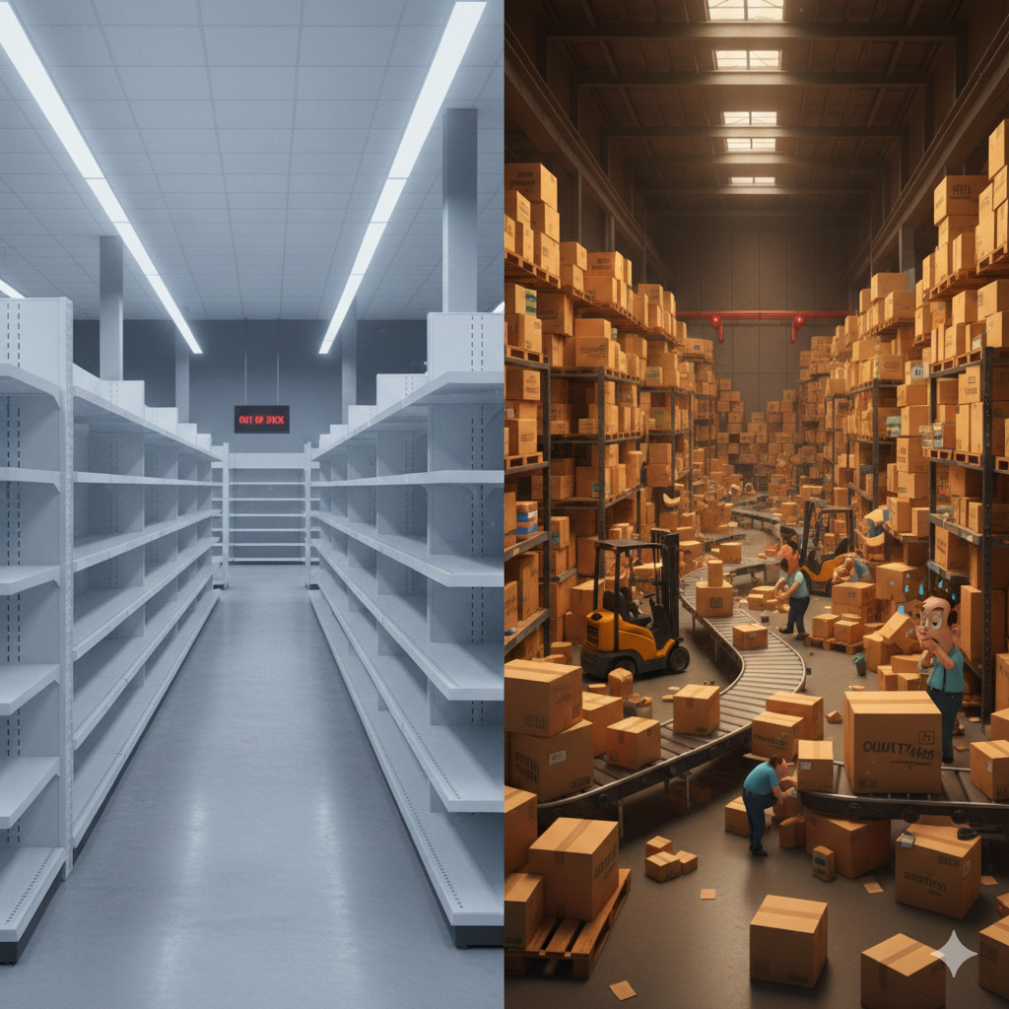
PROBLEM STATEMENT
Retail businesses struggle with accurate demand forecasting
Poor estimation leads to overstocking or loss of sales
Need for data-driven demand prediction

Slide 3



OBJECTIVES
Analyze historical sales data
Identify demand patterns and trends
Predict future demand using machine learning

Slide 4
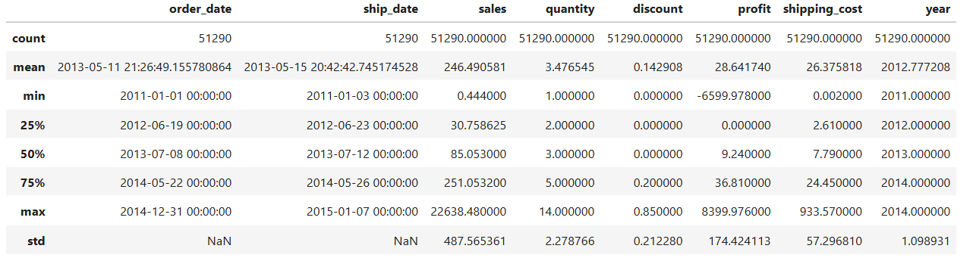
DATASET USED
Dataset Used
Retail sales dataset (Superstore Sales Data)
Data stored in Excel format
Contains historical transaction-level sales records
Key Features Used
Sales
Quantity
Discount
Profit
Shipping Cost

Slide 5
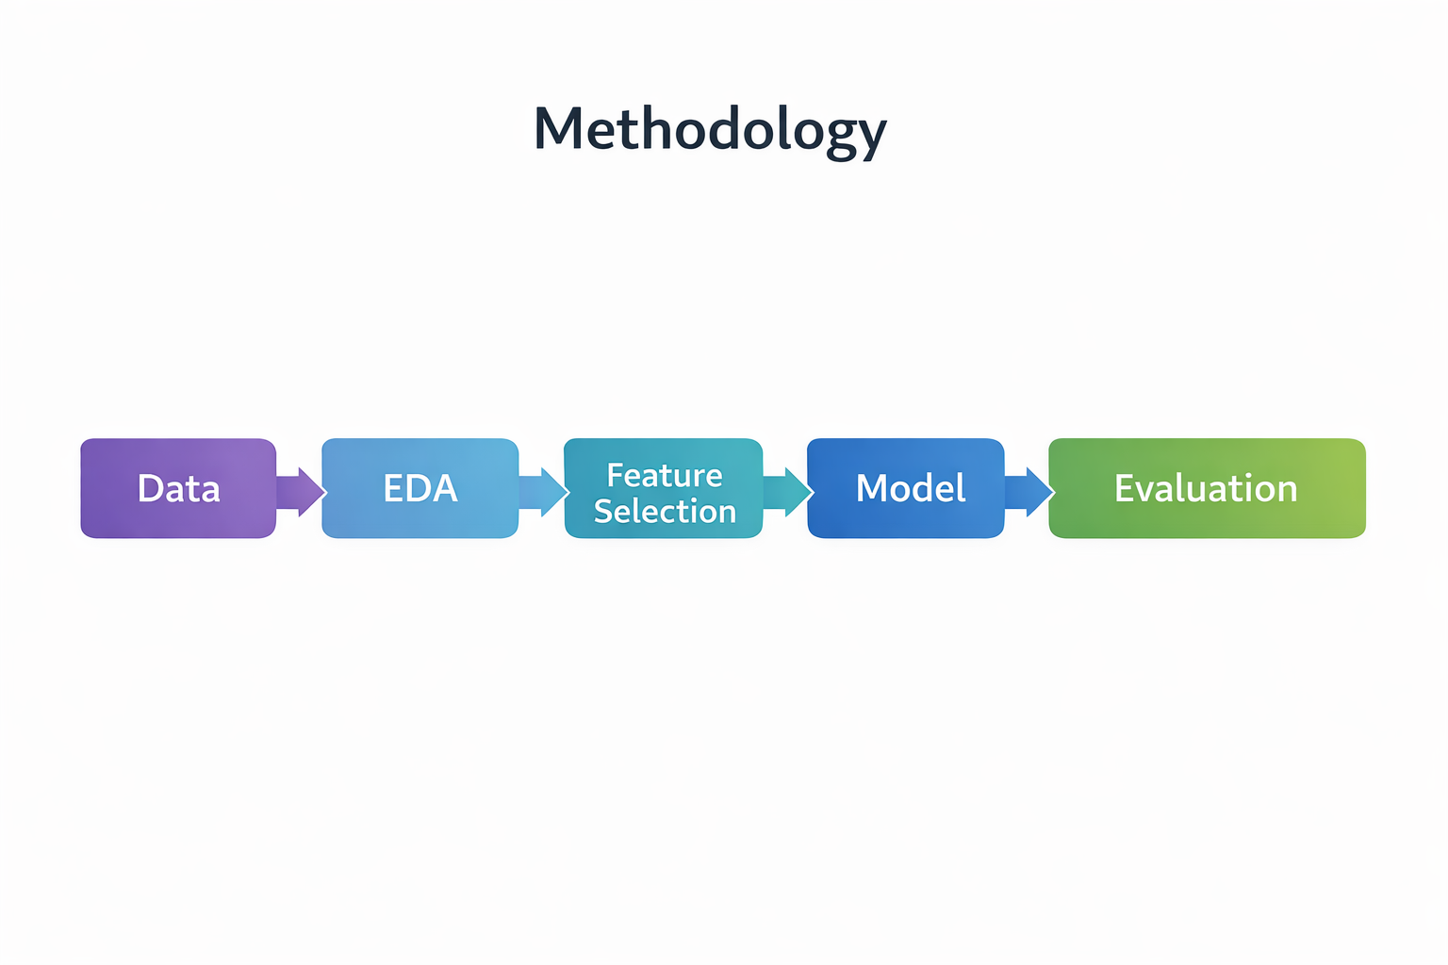
METHODOLOGY
Data loading and cleaning
Exploratory Data Analysis (EDA)
Correlation analysis
Feature selection
Machine learning model training

Slide 6
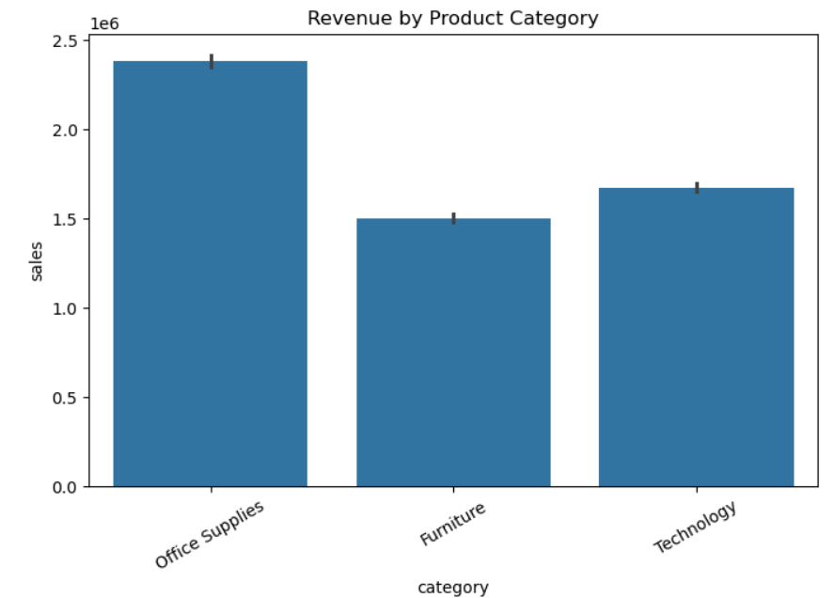
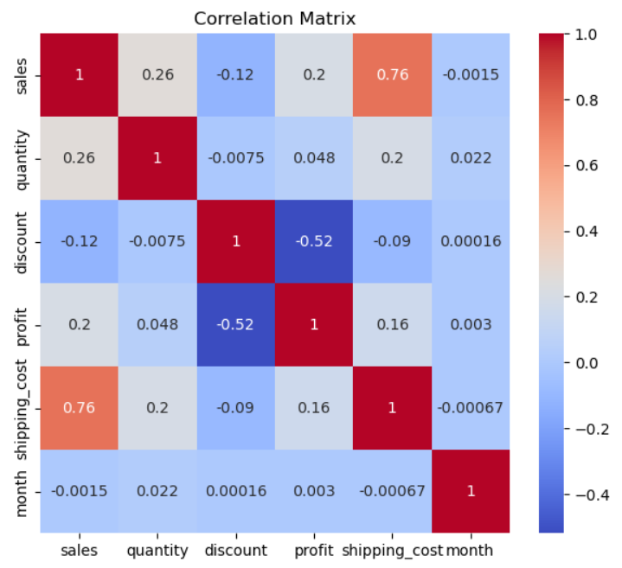
EXPLORATORY DATA ANALYSIS
Sales distribution analysis
Relationship between sales and other features
Correlation heatmap

Slide 7
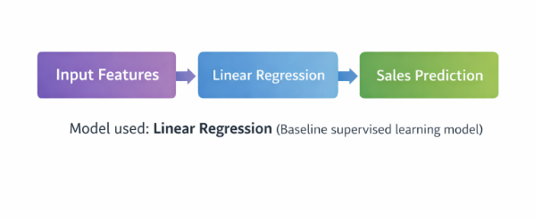
MACHINE LEARNING MODEL
Supervised learning approach
Linear Regression model
Predicts sales demand
Simple and interpretable model

Slide 8
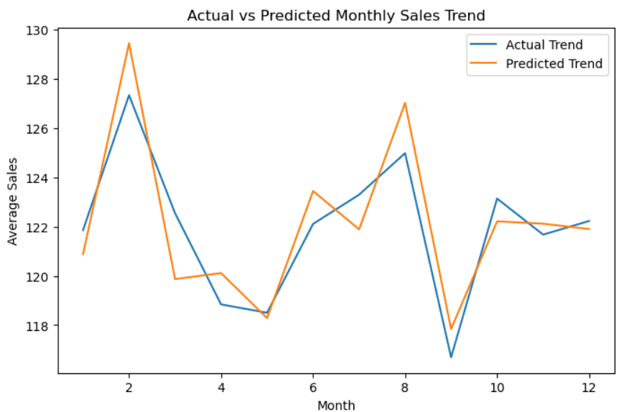
MODEL EVALUATION
Train-test data split
Performance metric: RMSE
Measures prediction accuracy

Slide 9
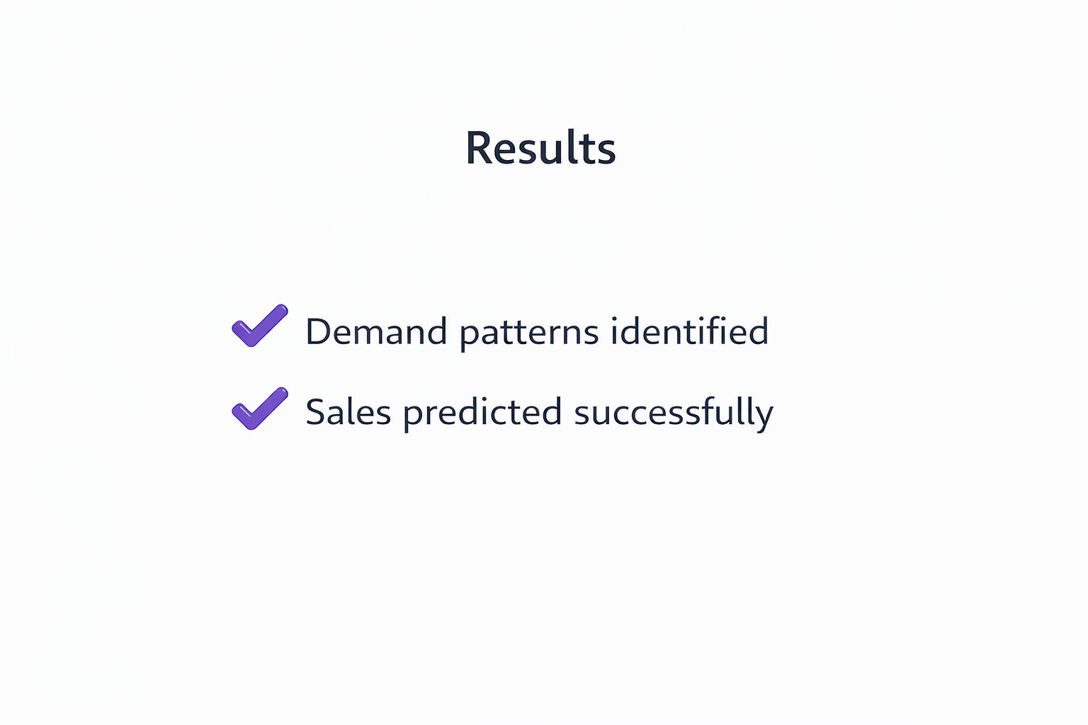
RESULTS
Model predicts sales with reasonable accuracy
Identifies key demand-influencing factors
Useful for retail decision-making

Slide 10

CONCLUSION & FUTURE SCOPE
Machine learning supports demand forecasting
Improves understanding of sales trends
Future scope:
Advanced models
Additional features
Real-time prediction

Slide 11
Thank you

